Slide 1
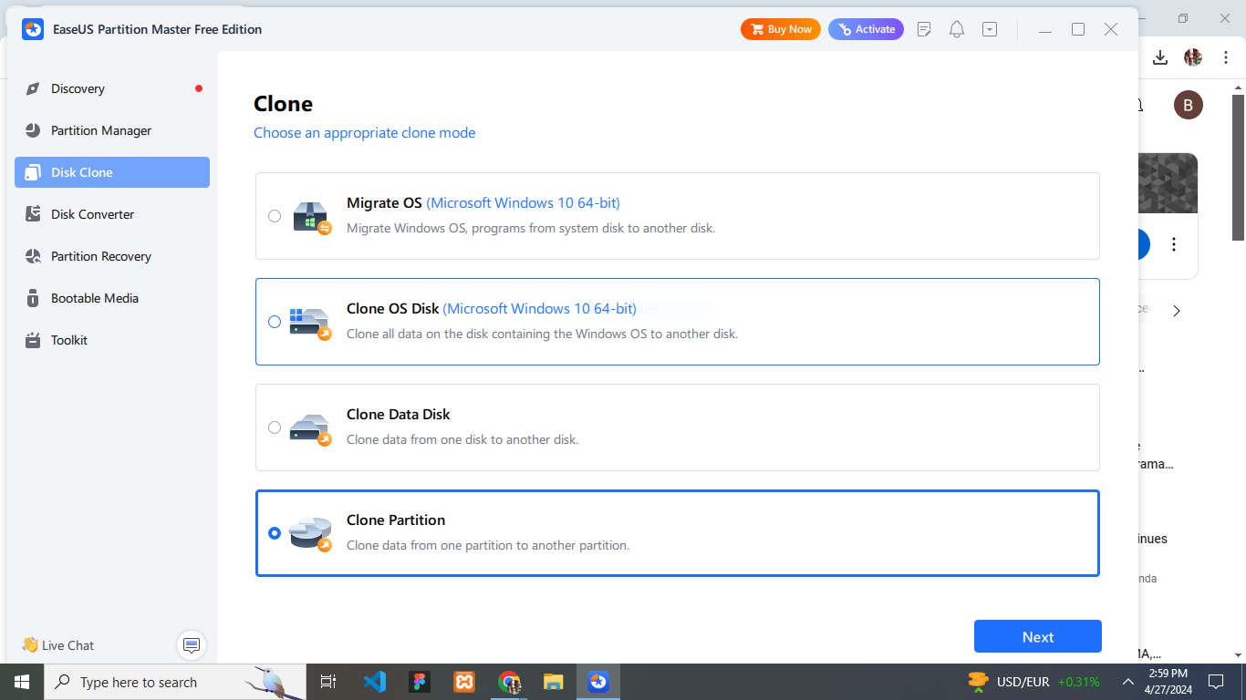
DISK CLONING
Disk cloning is the process of creating an exact copy or replica of an entire hard drive or solid-state drive (SSD), including its operating system, applications, data, and file structure.
PURPOSE OF DISK CLONING.
Backup and Disaster Recovery.
System Migration or Upgrades.
Deployment of Multiple Systems:
I used software called EaseUS Partition Master.

Slide 2
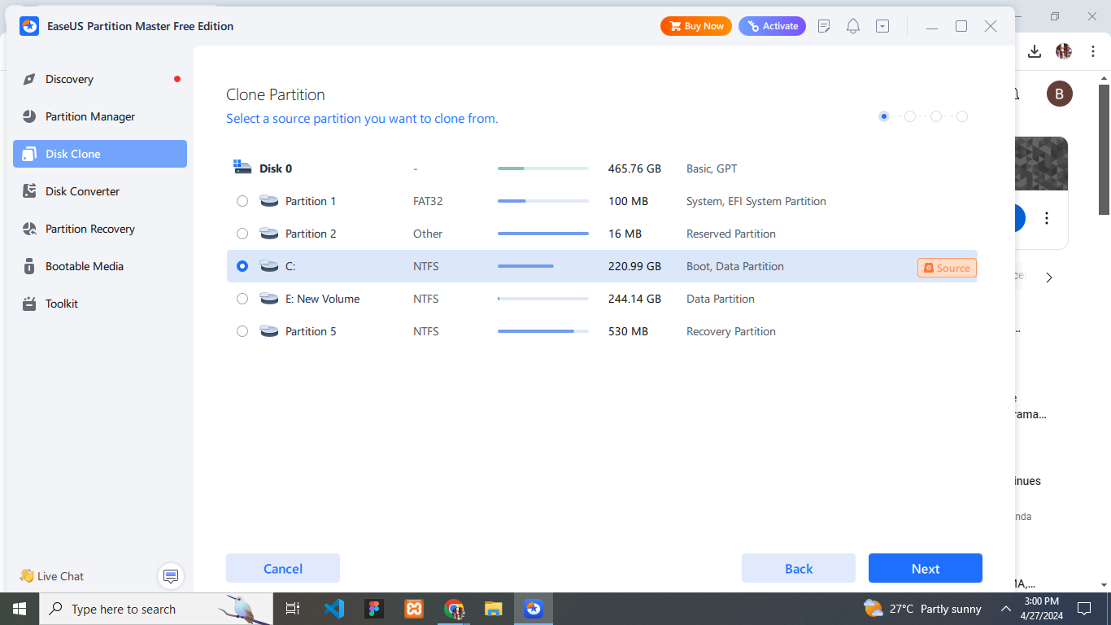
This is the selection of which partition(local disk C) you want to clone(source)

Slide 3
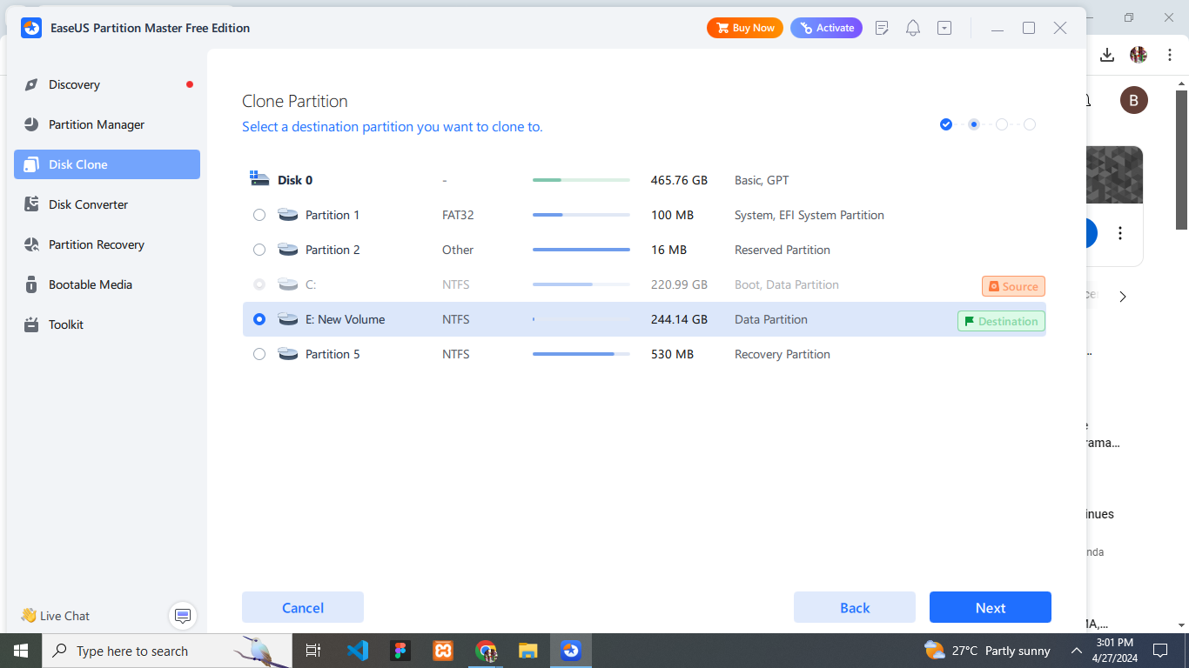
This is the selection of which partition(local disk D) (desitination)

Slide 4
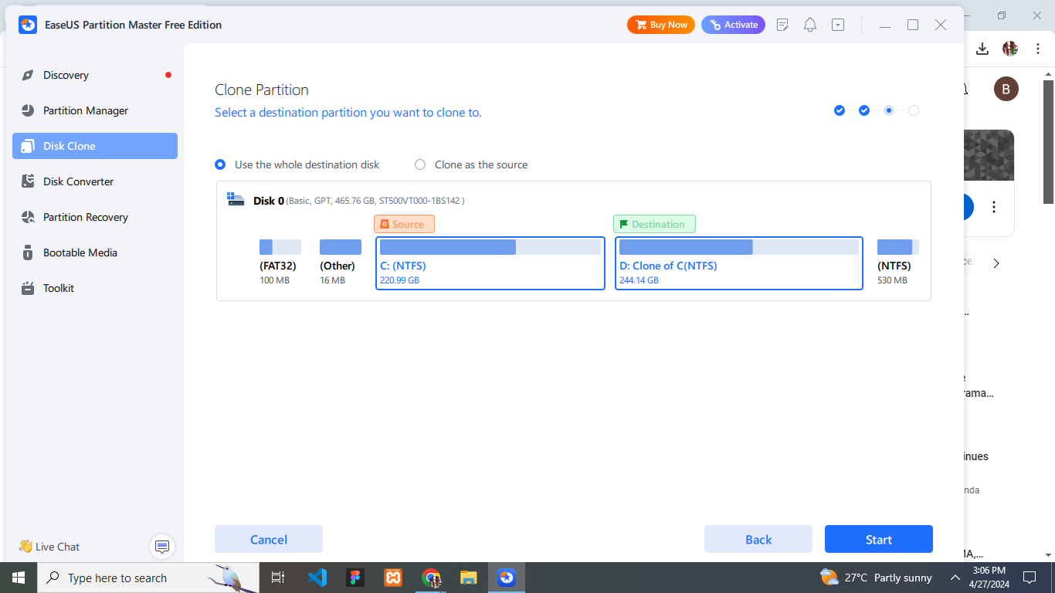
Start cloning

Slide 5
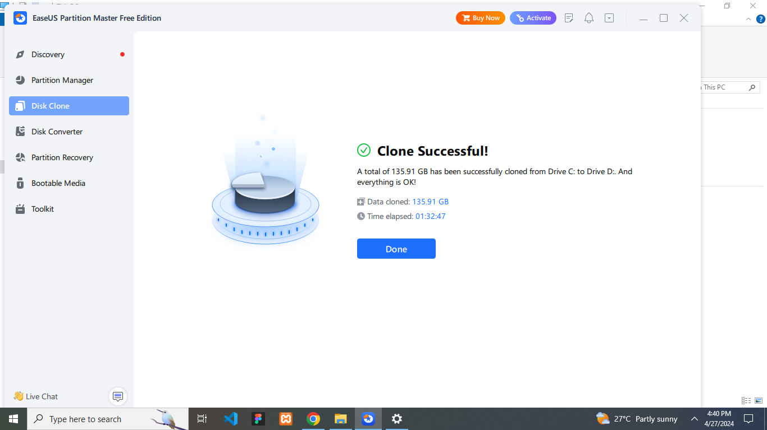
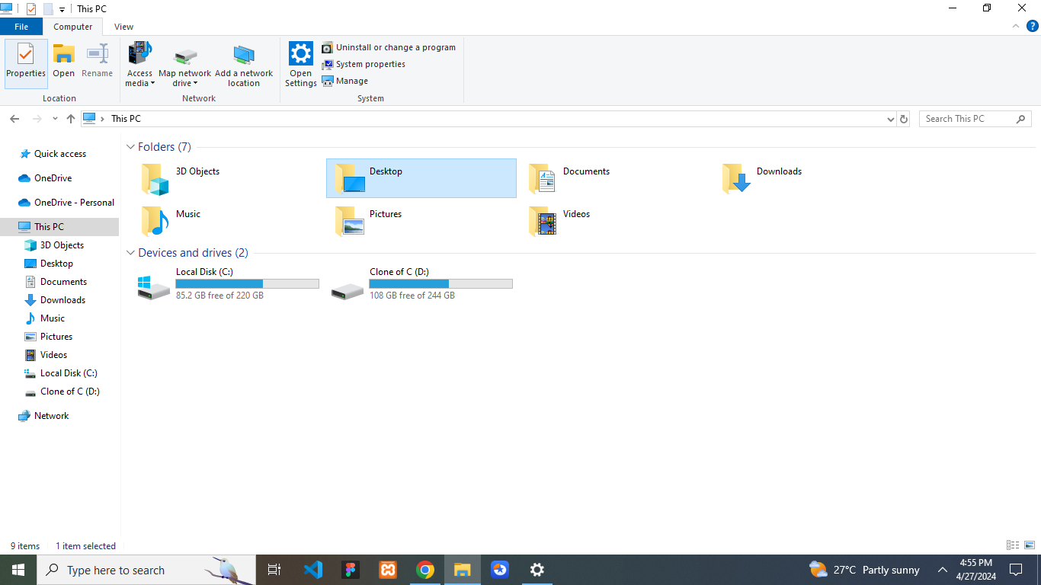
Successful clone

